Slide 1


Day 6 : ASP.NET Core

Slide 2














.NET is a software development platform
TOOLS
DESKTOP
WEB
CLOUD
MOBILE
GAMING
IoT
AI
VISUAL STUDIO
.NET STANDARD
VISUAL STUDIO FOR MAC
LIBRARIES
VISUAL STUDIO CODE
INFRASTRUCTURE
RUNTIME COMPONENTS
COMPILERS
LANGUAGES
COMMAND LINE INTERFACE
Notes:
.NET is an entire software development platform that takes care of a lot of the heavy lifting for you when you want to build an application. Applications frameworks help you build the specific types of apps or workloads and enable you to literally build any app for any platform with any operating system. Each .NET workload shares a common infrastructure and .NET Standard library. This means not only are your .NET skills portable, but your actual code is portable no matter what you’re building. This makes it easy to share reusable components (called libraries) across the breadth of applications people build.
Additionally, there are a broad set of development tools that makes it really productive to write, debug, build and manage code bases.
See: www.dot.net

Slide 3
The .NET Roadmap
Many
.NETs
2014
.NET FRAMEWORK
.NET CORE
XAMARIN / MONO
Runtime
Runtime
Runtime
Base class library
Core library
Mono class library

Slide 4
The .NET Roadmap
Many
.NETs
.NET
standard
2014
2016
.NET FRAMEWORK
.NET CORE
XAMARIN / MONO
Runtime
Runtime
Runtime
Base class library
Core library
Mono class library
.NET STANDARD

Slide 5
Introducing .NET 5
The .NET Roadmap
Many
.NETs
.NET
standard
.NET
2014
2016
Next
.NET FRAMEWORK
.NET CORE
.NET
XAMARIN / MONO
Runtime
Runtime
Runtime (JIT & native)
Runtime
Core library
Base class library
One base class library
Mono class library
.NET STANDARD

Slide 6









.NET—A unified platform
TOOLS
DESKTOP
WEB
CLOUD
MOBILE
GAMING
IoT
AI
WPF
Windows forms
UWP
ASP.NET
Azure
Xamarin
Unity
ARM32
ARM64
ML.NET
.NET for Apache Spark
VISUAL STUDIO
.NET STANDARD
VISUAL STUDIO FOR MAC
.NET 5
VISUAL STUDIO CODE
INFRASTRUCTURE
RUNTIME COMPONENTS
COMPILERS
LANGUAGES
COMMAND LINE INTERFACE

Slide 7
.NET 5 General Availability
Single file applications & smaller container images
Web and cloud investments
Windows desktop development enhancements
Windows ARM64 support
Continued performance improvements
New C# 9.0, F# 5.0 language features
dot.net/get-dotnet5
Notes:
I’m pleased to announce the general availability of .NET 5.
.NET 5 is the next version of .NET Core where we continue the journey of unifying the .NET platform. Our vision for one .NET is a unified set of libraries, tools/SDK and runtime. .NET 5 begins this with taking everything available in .NET Core and adding several cloud & web investments, such as smaller, faster single file apps that use less memory which are appropriate for microservices and containerized applications across operating systems. ASP.NET Blazor WebAssembly which allows you to write web UI in C# that runs completely in the browser, now uses the Core BCL (instead of Mono) further unifying the platform so developers can write code against the same base class libraries across all workloads. .NET 5 also embraces full Swagger support and makes it much easier to create testable, compatible, web APIs via OpenAPI. .NET 5 includes full design-time support for Windows Desktop development (WinForms and WPF) in Visual Studio, with first and third-party control support, Clickonce support, and side-by-side, single file deployment. There are also many runtime performance improvements, support for Windows ARM64, and new releases of languages C# 9.0 and F# 5.0.
And a HUGE thank you to all the contributors that have made an incredible improvements to the .NET 5 release. Hundreds of thousands of contributions, in fact. Open web browser to: https://dotnetthanks.azurewebsites.net/
Go get it and start building!
<CLICK>

Slide 8
– .NET 5 to 6 "wave"
One .NET vision
.NET Framework
Single SDK, one BCL, unified toolchain
Cross-platform native UI
Cross-platform web UI
Cloud native investments
Continue improvements in speed, size, diagnostics, Azure services
.NET
.NET Core
Mono / Xamarin
.NET has the best of breed solutions for all modern workloads
Notes:
Animated slide
Our vision for one .NET is to simplify the platform and choices for .NET developers and provide a single stack that supports the best of breed solutions for all modern workloads.
Last year, we shared a broad vision of a singular .NET stack and ecosystem. We're happy to report that we now have the foundation in place to deliver on that vision, in .NET 6.0. And we’ll continue to unify the platform in the next wave of releases. We are working towards a single SDK, one set of base class libraries and a unified toolchain. You saw today that down payment today with Blazor in .NET 5 now uses the .NET core libraries instead of the mono libraries. We will deliver cross-platform native UI with .NET MAUI, cross-platform web UI, and many more cloud native enhancements. We will always continue to improve speed, size and fundamentals of the platform. And .NET will always run best on Azure.
You will continue to see a wave of innovation happening with multiple previews along the way on the journey to one .NET.

Slide 9
.NET Schedule
Nov 2020
.NET 5.0
Nov 2021
.NET 6.0
LTS
Nov 2022
.NET 7.0
Nov 2023
.NET 8.0
LTS
Nov 2024
.NET 9.0
.NET 5.0 released on Nov 2020!
Major releases every year in November
LTS for even numbered releases
Predictable schedule, minor releases as needed
Notes:
We’re super excited to release .NET 5.0 to you today. Going forward we will release a major version every November. Long Term Support releases will land evrey other year on even number releases. Predictable releases helps everyone, not only the businesses that use .NET but also the open source projects that are built upon .NET.

Slide 10
ASP.NET Core
A cross-platform, high-performance, open-source framework for building modern, cloud-enabled, Internet-connected apps.
Is a redesign of ASP.NET 4.x, including architectural changes that result in a leaner, more modular framework
Ability to develop and run on Windows, macOS, and Linux
A lightweight, high-performance, and modular HTTP request pipeline.

Slide 11
Framework selection
ASP.NET Core | ASP.NET 4.x
Build for Windows, macOS, or Linux | Build for Windows
Razor Pages is the recommended approach to create a Web UI as of ASP.NET Core 2.x. See also MVC, Web API, and SignalR. | Use Web Forms, SignalR, MVC, Web API, WebHooks, or Web Pages
Multiple versions per machine | One version per machine
Develop with Visual Studio, Visual Studio for Mac, or Visual Studio Code using C# or F# | Develop with Visual Studio using C#, VB, or F#
Higher performance than ASP.NET 4.x | Good performance
Use .NET Core runtime | Use .NET Framework runtime

Slide 12
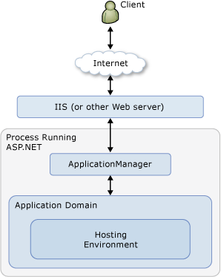
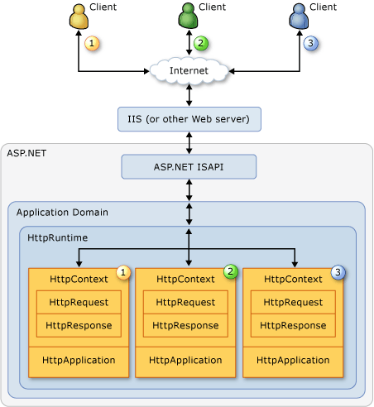
Hosting in Windows

Slide 13
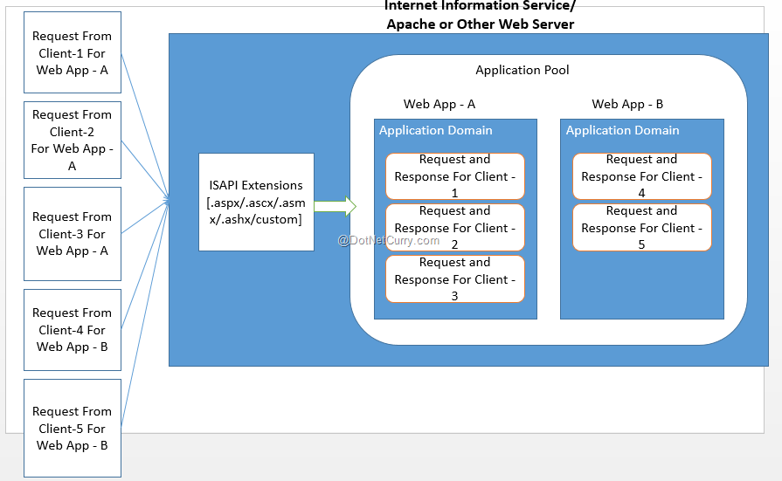
IIS Internals

Slide 14
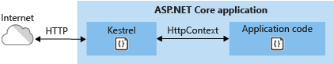
Web server implementations - ASP.NET Core
Kestrel
default, cross-platform HTTP server implementation
provides the best performance and memory utilization
doesn't have some of the advanced features in HTTP.sys
Agility, it's developed and patched independent of the OS.
Notes:
An ASP.NET Core app runs with an in-process HTTP server implementation. The server implementation listens for HTTP requests and surfaces them to the app as a set of request features composed into an HttpContext.
Kestrel is supported on all platforms and versions that .NET Core supports.
It’s a listening server and a command-line interface. It is based on the libuv library, the same one used by node.js. Libuv supports an event-driven style of programming. Some of its core utilities include non-blocking network support and asynchronous file system access with other benefits.
The Kestrel web server is not meant to be an Internet facing web server, but rather an application server that handles very specific data processing tasks. Kestrel is optimized for application scenarios and it not meant for other things like static file serving or managing the server’s lifetime.

Slide 15
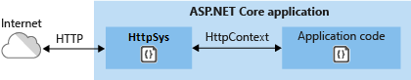
Web server implementations - ASP.NET Core
HTTP.sys
web server for ASP.NET core that runs only on Windows
alternative to Kestrel and also provides some extra features
Supports windows authentication, port sharing, web sockets
Agility, it's developed and patched independent of the OS.
Notes:
HTTP.sys isn't compatible with the ASP.NET Core Module and can't be used with IIS or IIS Express
HTTP.sys is useful for deployments where:
There's a need to expose the server directly to the Internet without using IIS.
An internal deployment requires a feature not available in Kestrel.
HTTP.sys is mature technology that protects against many types of attacks and provides the robustness, security, and scalability of a full-featured web server. IIS itself runs as an HTTP listener on top of HTTP.sys

Slide 16
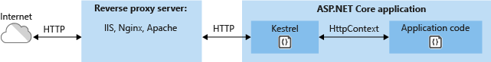
Web Server implementations - ASP.NET Core
IIS
A flexible, secure and manageable Web Server for hosting web apps, including ASP.NET Core.
Supports Windows Only
Needs a module called ASP.NET Core Hosting Bundle to be installed
Supports In Process as well as out-of-process hosting
Notes:
“In earlier versions of ASP.NET Core, IIS serves as a reverse proxy. In 2.2, the ASP.NET Core Module can boot the CoreCLR and host an app inside the IIS worker process (w3wp.exe). In-process hosting provides performance and diagnostic gains when running with IIS.”
The ASP.NET Core Module is a native IIS module that plugs into the IIS pipeline, allowing ASP.NET Core applications to work with IIS. Run ASP.NET Core apps with IIS by either:

Slide 17
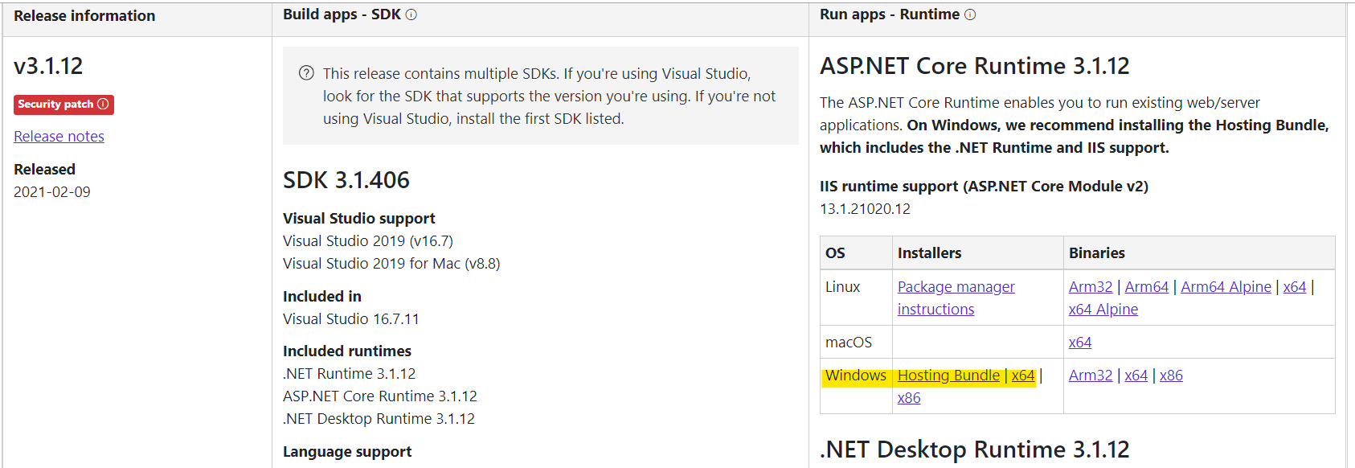
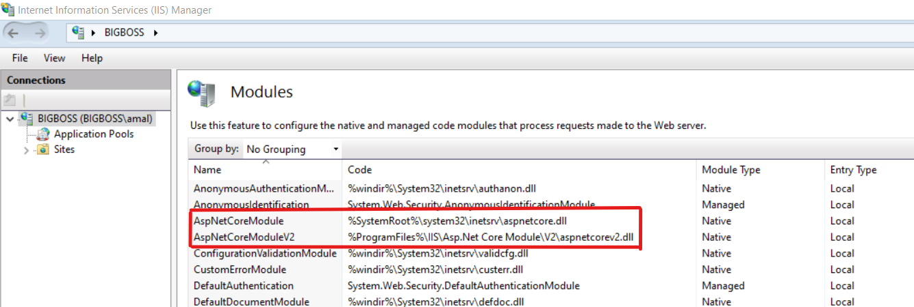
ASP.NET Core Hosting Bundle
An installer for the .NET Core Runtime and the ASP.NET Core Module
Notes:
“In earlier versions of ASP.NET Core, IIS serves as a reverse proxy. In 2.2, the ASP.NET Core Module can boot the CoreCLR and host an app inside the IIS worker process (w3wp.exe). In-process hosting provides performance and diagnostic gains when running with IIS.”
The ASP.NET Core Module is a native IIS module that plugs into the IIS pipeline, allowing ASP.NET Core applications to work with IIS. Run ASP.NET Core apps with IIS by either:

Slide 18
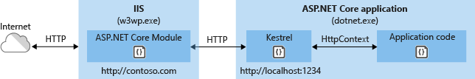
IIS – Out-of-Process Hosting
Runs an ASP.NET Core app as a diff process
Performance hit is there
Notes:
The earlier versions of ASP.NET Core required you to host the application in IIS using an Out-of-Process hosting model that proxies through IIS
Requests that hit IIS or IISExpress are forwarded to the ASP.NET Core web application running within Kestrel Web Server
In the Out-Of-Process hosting model the ASP.NET Core application runs in a separate process from that of the IIS or IIS Express process.
This was the case for all ASP.NET Core application prior to version 2.2
In this model the IIS basically acts like a proxy server.

Slide 19
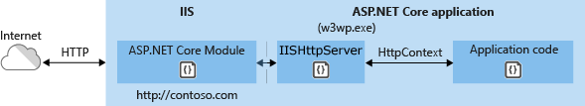
IIS – In-Process Hosting
Runs an ASP.NET Core app in the same process as its IIS worker process
Provides improved performance because requests aren't proxied
Notes:
Instead of forwarding requests to Kestrel, a new Web Server implementation (IISHttpServer) is hosted directly inside the IIS Application Pool, which then serves the request.
A request arrives from the web to the kernel-mode HTTP.sys driver.
The driver routes the native request to IIS on the website's configured port, usually 80 (HTTP) or 443 (HTTPS).
The ASP.NET Core Module receives the native request and passes it to IIS HTTP Server (IISHttpServer). IIS HTTP Server is an in-process server implementation for IIS that converts the request from native to managed
After the IIS HTTP Server processes the request:
The request is sent to the ASP.NET Core middleware pipeline.
The middleware pipeline handles the request and passes it on as an HttpContext instance to the app's logic.
The app's response is passed back to IIS through IIS HTTP Server.
IIS sends the response to the client that initiated the request.

Slide 20
Configuration File
<?xml version="1.0" encoding="utf-8"?>
<configuration>
<location path="." inheritInChildApplications="false">
<system.webServer>
<handlers>
<add name="aspNetCore" path="*" verb="*" modules="AspNetCoreModuleV2" resourceType="Unspecified" />
</handlers>
<aspNetCore processPath="dotnet"
arguments=".\MyApp.dll"
stdoutLogEnabled="false"
stdoutLogFile=".\logs\stdout"
hostingModel="inprocess" />
</system.webServer>
</location>
</configuration>
Notes:
The web.config is a file that is read by IIS and the ASP.NET Core Module to configure an app hosted with IIS.
The ASP.NET Core Module is configured with the aspNetCore section of the system.webServer node in the site's web.config file.
file must be present at the content root path (typically the app base path) of the deployed app
During publishing
If a web.config file isn't present in the project, the file is created with the correct processPath and arguments to configure the ASP.NET Core Module and moved to published output.
If a web.config file is present in the project, the file is transformed with the correct processPath and arguments to configure the ASP.NET Core Module and moved to published output. The transformation doesn't modify IIS configuration settings in the file.

Slide 21
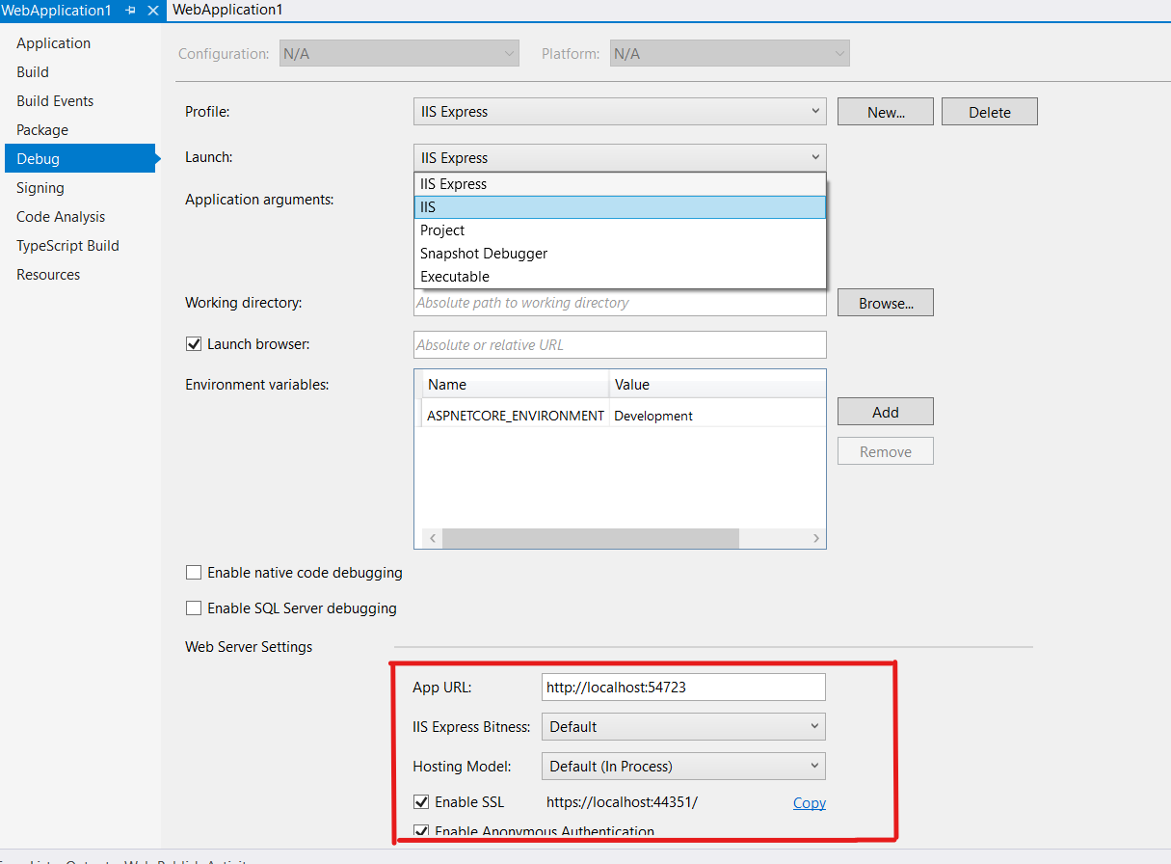
Visual Studio Integration
Notes:
Instead of forwarding requests to Kestrel, a new Web Server implementation (IISHttpServer) is hosted directly inside the IIS Application Pool, which then serves the request.
A request arrives from the web to the kernel-mode HTTP.sys driver.
The driver routes the native request to IIS on the website's configured port, usually 80 (HTTP) or 443 (HTTPS).
The ASP.NET Core Module receives the native request and passes it to IIS HTTP Server (IISHttpServer). IIS HTTP Server is an in-process server implementation for IIS that converts the request from native to managed
After the IIS HTTP Server processes the request:
The request is sent to the ASP.NET Core middleware pipeline.
The middleware pipeline handles the request and passes it on as an HttpContext instance to the app's logic.
The app's response is passed back to IIS through IIS HTTP Server.
IIS sends the response to the client that initiated the request.

Slide 22
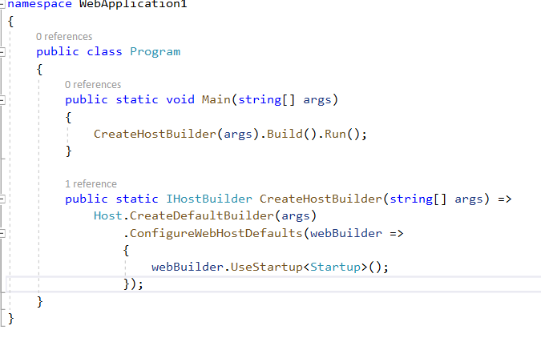
Program.cs
Notes:
On startup, an ASP.NET Core app builds a host. The host encapsulates all of the app's resources, such as:
An HTTP server implementation
Middleware components
Logging
Dependency injection (DI) services
Configuration
There are two different hosts:
.NET Generic Host
ASP.NET Core Web Host
The .NET Generic Host is recommended. The ASP.NET Core Web Host is available only for backwards compatibility.
The CreateDefaultBuilder and ConfigureWebHostDefaults methods configure a host with a set of default options, such as:
Use Kestrel as the web server and enable IIS integration.
Load configuration from appsettings.json, appsettings.{Environment Name}.json, environment variables, command line arguments, and other configuration sources.
Send logging output to the console and debug providers.

Slide 23
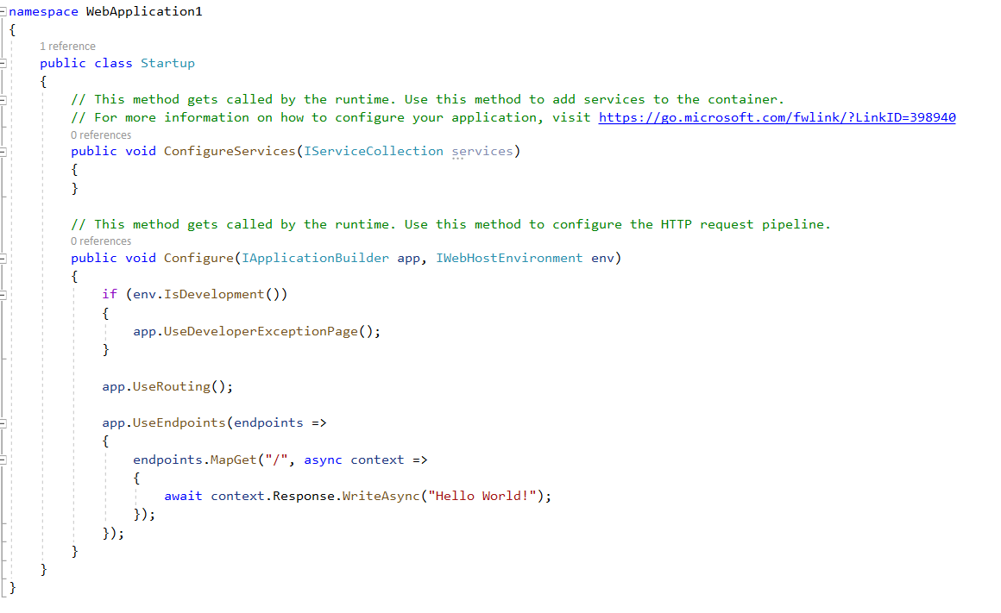
Startup.cs
Notes:
startup.cs is mandatory, it can be decorated with any access modifier like public, private, internal. Multiple Startup classes are allowed in a single application. ASP.NET Core will select the appropriate class based on its enviroment. If a class Startup{EnvironmentName} exists, that class will be called for that EnvironmentName or Environment Specific startup file will be executed to avoid frequent changes of code/setting/configuration based on environment.
Configure Method
The Configure method is used to specify how the application will respond in each HTTP request. This method is mostly used for registering middleware in HTTP pipelin

Slide 24

Thanks for joining!
Ask questions on Twitter using #dotNETConf
Notes:
Thanks for joining us! Have a great conference!

